Slide 1
Integrating Technology
Module 2
Families
Notes:
Trainer Does:
Introduce yourself and share the module title and subtitle.
Share opening video by clicking on the robot slide. Technology Summary Final - YouTube
Emphasize the following key points:
How can media be used in positive ways to support children’s learning and healthy development.
It’s important to keep tabs on the amount of time children spend using media — not necessarily eliminate it — and balance their time at home with opportunities to learn and grow.
Picture retrieved from: The Division of Early Learning

Slide 2
Agenda
Division of Early Learning’s (DEL’s) Best Practices
Guiding Principles
Florida Early Learning and Developmental Standards Resources
Notes:
Trainer Says:
Before beginning module, it will be helpful to download the following documents: “DEL’s Best Practices for Integrating Technology and Interactive Media with Preschoolers”, and “Florida Early Learning and Developmental Standards” located at the Content Support Documents section of the Professional Learning Module: “Integrating the Standards: Intentional Use of Technology and Interactive Media in Early Learning” of the Director’s Toolkit, http://flbt5.floridaearlylearning.com/dirtoolplm.html.
Trainer Does:
Read the agenda items to the participants.

Slide 3
Best Practices: Activity
The Division of Early Learning (DEL) has reviewed contemporary research through the lens of developmentally appropriate practice to provide insight into how families and educators might effectively support preschoolers to meaningfully engage with, and benefit from, technology and interactive media.
Notes:
Trainer Says:
As we look through the Best Practices document from DEL, we will be reflecting on the Technology and Families section, which focuses on how parents/caregivers can support their children when using technology. I will give you a few minutes to read the passage and later we will have a brief reflection.
What do you agree with the passage?
What do you disagree?
What direction will you begin to take as an Early Educator?
Trainer Does:
Assigns group to review the Technology and Families section and reflect as a whole group.
Trainer Needs to Know:
If each section was completed during Module 1, refer group/participant to highlight the importance of technology and families.

Slide 4
Guiding Principles Overview
Technology and interactive media can be used to support and enhance relationships between families, educators, communities, and young children (U.S. Department of Education, & U.S. Department of Health and Human Services, 2016).
The use of technology and interactive media with young children is most effective when adults act as viewing partners and provide thoughtful interaction throughout the experience (Zero to Three, 2014).
Notes:
Trainer Does:
Read both guiding principles to the participants.
Trainer Says:
“We will explore these principles further.”

Slide 5
Guiding Principle
The use of technology and interactive media with young children is most effective when adults act as viewing partners and provide thoughtful interaction throughout the experience (Zero to Three, 2014).
Notes:
Trainer Does:
Ask participants the following questions :
“What do you agree with Zero to three’s guiding principle?
“What do you want to argue with in the guiding principle?
“What parts of the guiding principles do you want to aspire to?

Slide 6
How can families provide thoughtful interaction through the use of technology?
Discussion
Notes:
Trainer Does:
Ask participants the question on the slide and use the following technology tools to view responses.
Use the features of your video conferencing platforms, for example, Zoom’s chat, whiteboard, etc.
The following tools can be used to support this activity, if trainer is comfortable with them.
Padlet- https://padlet.com/
Dotstorming- https://dotstorming.com/

Slide 7
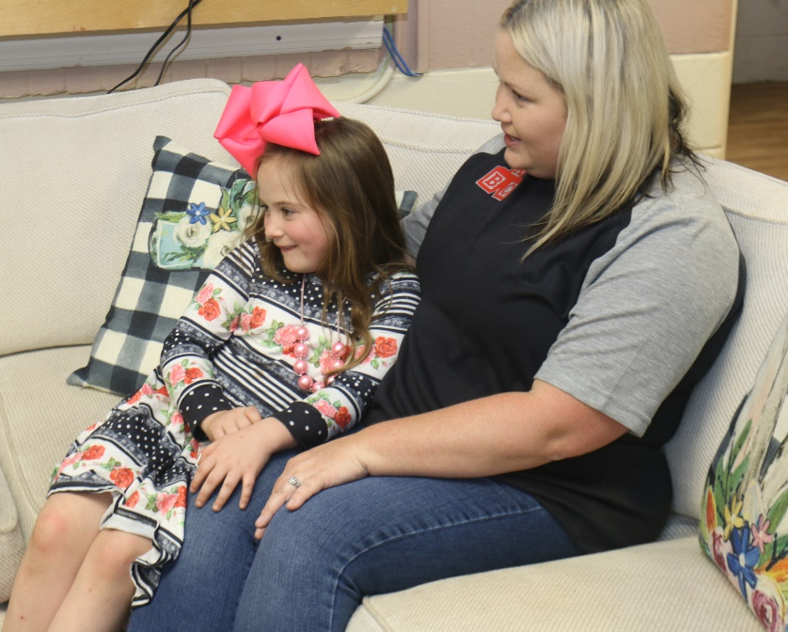
DEL Suggests
Research suggests that parental media use is a strong predictor of children’s future media behaviors.
It is essential that families provide both balance and moderation when using technology and interactive media with, and around, young children.
Notes:
Trainer Notes:
Trainer will read the DEL’s suggestion on the slide and provide a few important key points below.
1. Prioritize language-promoting activities you can do with your child at home that don’t involve screens, like book reading and having back-and-forth conversations.
2. Interact with your child while using media at home. Use digital apps and games alongside your child to expose them to new vocabulary and concepts and enhance the learning experience by asking questions.
Pictures retrieved from The Division of Early Learning

Slide 8
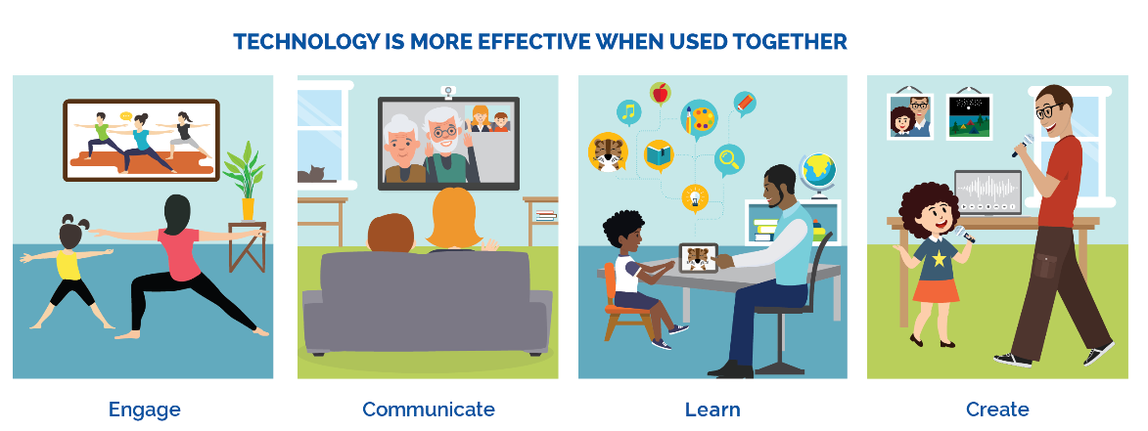
Figure 1: National Educational Plan (2020)
https://tech.ed.gov/files/2016/10/Early-Learning-Tech-Graphic1.png
Effective Use of Technology
Notes:
Trainer Says:
According to DEL’s Best Practices, there are many ways that adult involvement can make learning more effective for young children using technology. Adult guidance that can increase active use of more passive technology includes, but are not limited to, the following:
Prior to the child viewing content, an adult can talk to child about the content and suggest certain elements to watch for or pay particular attention to;
An adult can view the content with the child and interact with the child in the moment;
After a child views the content, an adult can engage the child in an activity that extends learning such as singing a song they learned while viewing the content or connecting the content to the world.”

Slide 9
Guiding Principle
Technology and interactive media can be used to support and enhance relationships between families, educators, communities, and young children.
U.S. Department of Education, & U.S. Department of Health
and Human Services, 2016
Notes:
Trainer Notes:
Trainer will ask the following questions to participants:
“What do you agree with in this guiding principle?
“What do you want to argue with in the guiding principle?
“What parts of the guiding principles do you want to aspire to?

Slide 10
Discussion
How can technology and interactive media be used to support and enhance relationships with families ?
Notes:
Trainer Does:
Ask participants the question on the slide and use the following technology tools to view responses.
Use the features of your video conferencing platforms, for example, Zoom’s chat, whiteboard, etc.
The following tools can be used to support this activity, if trainer is comfortable with them.
Padlet- https://padlet.com/
Dotstorming- https://dotstorming.com/

Slide 11
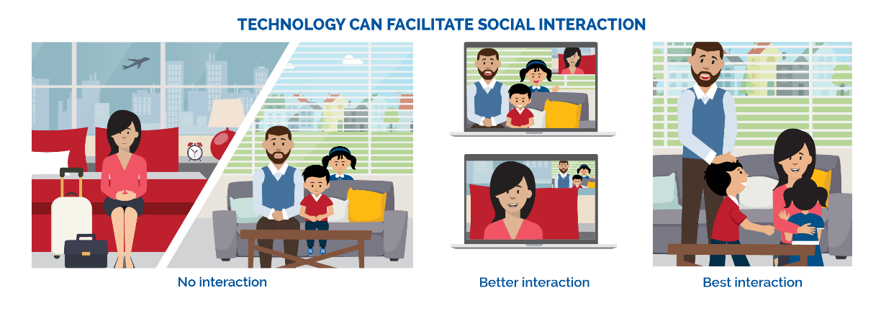
Figure 2: National Educational Plan (2020)
https://tech.ed.gov/files/2016/10/Early-Learning-Tech-Graphic2.png
Technology and Social Interaction
Notes:
Trainer Says:
According to DEL’s Best Practices, “While technology has the power to bridge the physical divide between children and loved ones in the ways described, technology should not be used to replace meaningful face-to-face interactions.”

Slide 12
DEL Best Practices Suggests
Young children benefit from strong media role models and limited screen time.
Notes:
Trainer Does:
Read DEL’s Best Practices suggestions on how interactive media can be used as a tool to support families.
Click on image to access website.
Trainer says:
According to our DEL’s Best Practices document, technology should never take the place of hands-on activities, unstructured play, and social interactions, which are all strongly correlated to the development of cognitive, language and social skills.

Slide 13
What are families advised to do?
Discussion
Notes:
Trainer Does:
Ask participants the question on the slide and use the following technology tools to view responses.
Use the features of your video conferencing platforms, for example, Zoom’s chat, whiteboard, etc.
The following tools can be used to support this activity if trainer is comfortable with them.
Padlet- https://padlet.com/
Dotstorming- https://dotstorming.com/

Slide 14
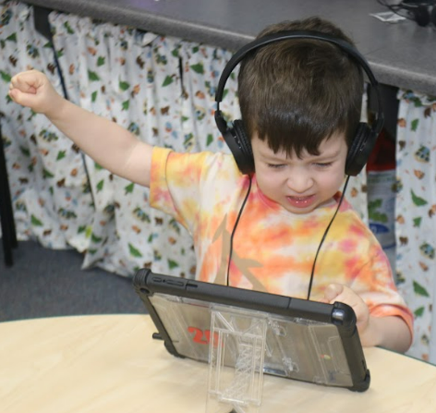
DEL Suggests
Families are advised to consider the child, content, and context
The child’s age, interests, abilities, emerging skills and attention span are important factors when choosing appropriate technology and interactive media.
Content should be meaningful, relevant to real life, interactive, and engaging.
Finally, the context of the media experience is important to consider.
Notes:
Trainer Does:
Read the bulleted key points on the slide
Trainer says:
Before using media with children, ask yourself the following questions:
How does this help children engage, express, imagine or explore?
How does it complement (not interrupt) children’s natural play?
How do we choose the right tech tools?

Slide 15
What technology tips and tools can families use to support their children’s learning ?
Discussion
Notes:
Trainer Does:
Ask participants the question on the slide and use the following technology tools to view responses.
Use the features of your video conferencing platforms, for example, Zoom’s chat, whiteboard, etc.
The following tools can be used to support this activity, if trainer is comfortable with them.
Padlet- https://padlet.com/
Dotstorming- https://dotstorming.com/

Slide 16
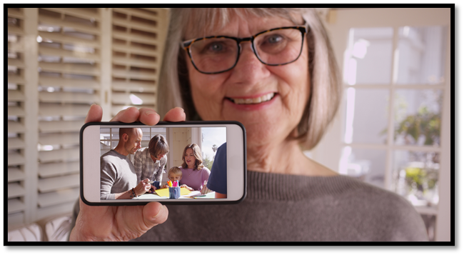
Tips to Engage Families
Gather Information
Document and share
Share favorite apps
Open communications pathways
Meet families where they are
Model and discuss appropriate tech use
Notes:
Trainer Says:
Here are a few examples on how to engage families through the use of technology and media.
Gather information: Teachers can create a survey to determine if the children’s families own tech tools like computers, smart phone or tablets.
Document and Share: Invite family members to document early learning activities at home using technology—for example, a family can make a video of their child explaining the story behind her drawing.
Share favorite apps: The Division of Early Learning family page has links to developmentally appropriate apps like vroom. (Be intentional) Vroom is not an application for a child to use but for families to gather ideas on how brain building activities for their children. Use of media should be age, linguistically, individually and culturally appropriate in order to promote positive learning outcomes. Visit DEL’s Family link: http://flbt5.floridaearlylearning.com/families.html
Open communication pathways: Providing flexible differentiated ways of communication and instruction can enhance school and family connection. (zoom, google hangouts, What’s-app, class dojo)
Meet families where they are: Promote equity in supporting families and educators by eliminating technology barriers that include access and location. (provide access to a family’s home language and culture)
Model and Discuss appropriate tech use: Consider screen time when determining appropriate limits to preschool age children based on a home or school flexible environment. (setting up a schedule or routine)
Trainer Notes:
Picture retrieved from The Division of Early Learning.

Slide 17
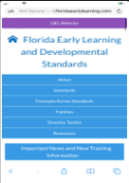
Florida Early Learning and Development Standards (FELDS)
FELDS Website to Support Families
Notes:
Trainer Does:
Read the slide.
Click on image to access website.
Explore the FELDS website and provide participants with a virtual walkthrough of the family section.
Picture retrieved from Florida Early Learning and Developmental Standards-Link: http://flbt5.floridaearlylearning.com/index.html

Slide 18
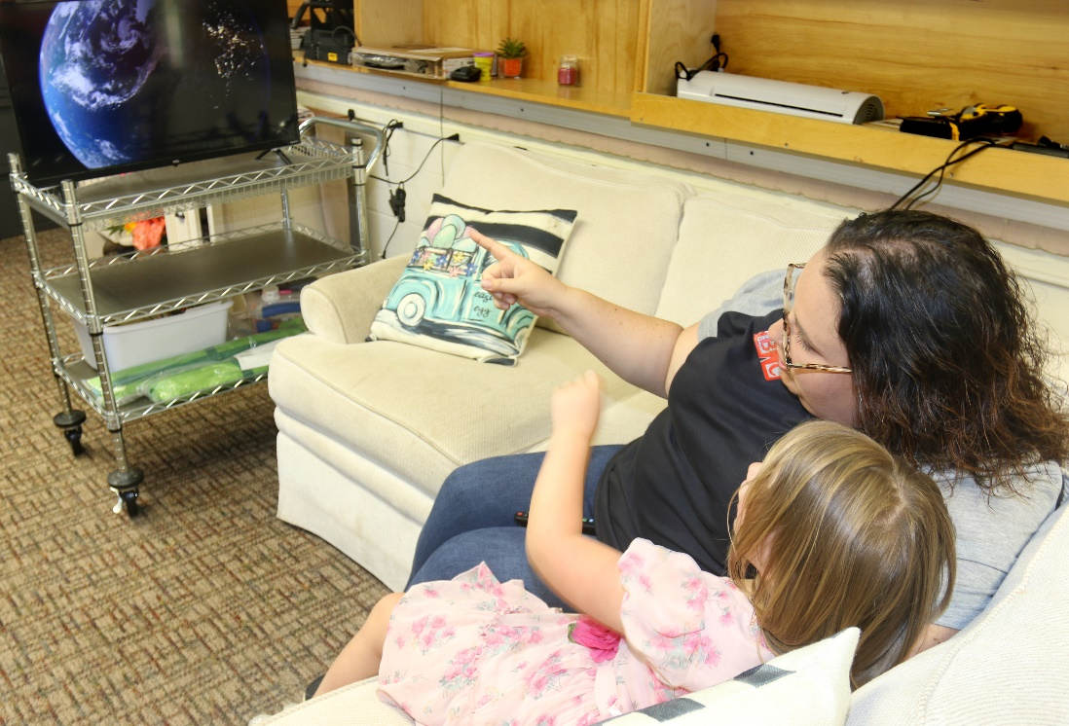
18
“Families May”
Actively participate with your child
Monitor children’s screen time
Discuss how tools and technology assist our daily lives
Notes:
Trainer Does:
Read each “Families may” statement and provide the following examples.
Actively participate with your child when watching television or using the computer, and limit daily screen time, especially before bedtime.
Monitor children’s screen time for quality and appropriate content.
Discuss how tools and technology assist our daily lives (e.g., electricity, plumbing, cars, computers, etc.)
Trainer Says:
By exploring the Florida Early Learning and Developmental Standards (FELDS) website, you will be able to locate how families can support their children by implementing the use of technology.

Slide 19
Discussion
How can families take control of the technology
in their child’s lives?
Notes:
Trainer Does:
Ask participants the question on the slide and use the following technology tools to view responses.
Use the features of your video conferencing platforms, for example, Zoom’s chat, whiteboard, etc.
The following tools can be used to support this activity, if trainer is comfortable with them.
Padlet- https://padlet.com/
Dotstorming- https://dotstorming.com/
Explore DEL’s Best Practices suggested resources. For example, Common Sense Media and PBS websites.
Seek out high-quality, research-based media products and programs for children to engage with at home.
Search Common Sense Media for age-appropriate programs and explore the PBS Kids network and app for a variety of educational games and programs that have been created with quality in mind.

Slide 20
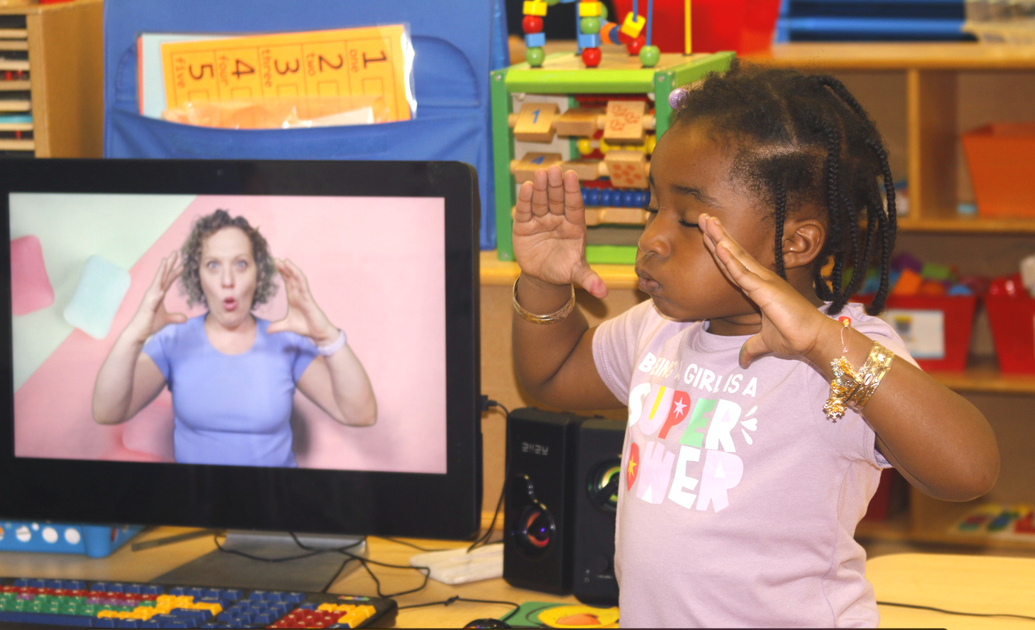
Choosing Media Content
Engaging
Actively Involved
Meaningful
Social
Notes:
Trainer Says:
DEL’s Florida Early Learning and Development Standards (FELDS) family section and share links to standards for each age group and list ideas for supporting children in all domains under the “Families May” sections. Division of Early Learning - Early Learning and Developmental Standards (floridaearlylearning.com)
Refer to the E-Aims Model resource for this slide discussion.
Engaging e-book (avoid pop-ups or outside features not related to story)
Active involvement with the content
Does it reflect child’s everyday life and experiences? (avoid too many imaginary elements, unfamiliar activities)
Does it encourage child to talk, respond and interact with me?
Choosing Media Content for Young Children Using the E-Aims Model / zerotothree.org screen sense Engaging Actively Involved Meaningful Social
Picture retrieved from the Florida Early learning Standards Website-Family Section

Slide 21
Notes:
Trainer Does:
Show video and discuss
Ask the following:
What examples of actively involved, meaningfully involved and social engagement did you see in this clip?

Slide 22
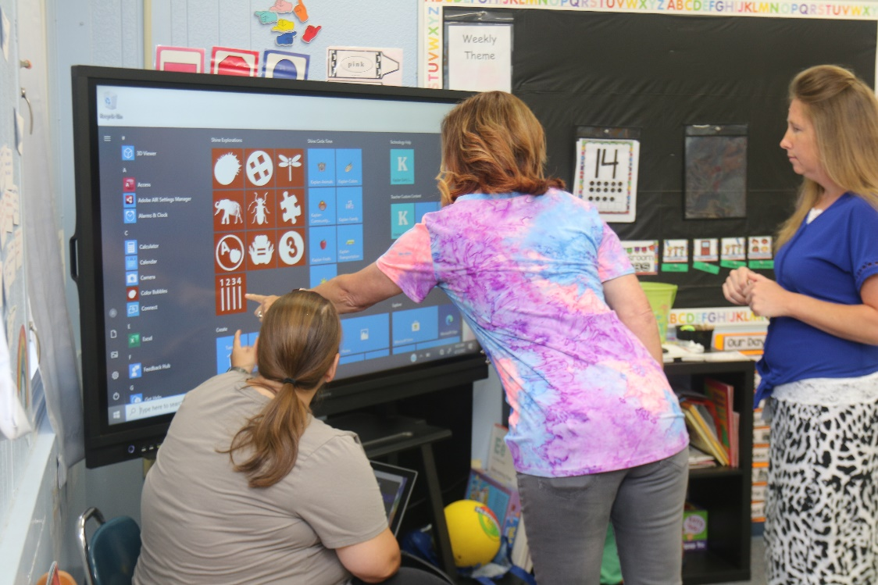
Next Steps
Revisit Tech Resources
Review the Support Documents and Instructional Resources in the module.
Find a teacher/partner, director or coach to support you as you rethink how to connect with families.
Notes:
Trainer Notes:
Discuss the next steps for participants to complete.
Ask the following questions to participants:
How will you share these resources with families? Example, parent teacher conferences, open houses, meets and greets, etc.
What recommendations would you provide to families in helping them navigate the digital world? For example, commonsense media. org is a great support document resource that guides families in choosing age-appropriate apps and websites.
Trainer Needs To Know:
This completes the Technology Module. Optional: Trainer can create a reflection session (virtual or in person) where participants can provide best practices and recommendations.

